Slide 1
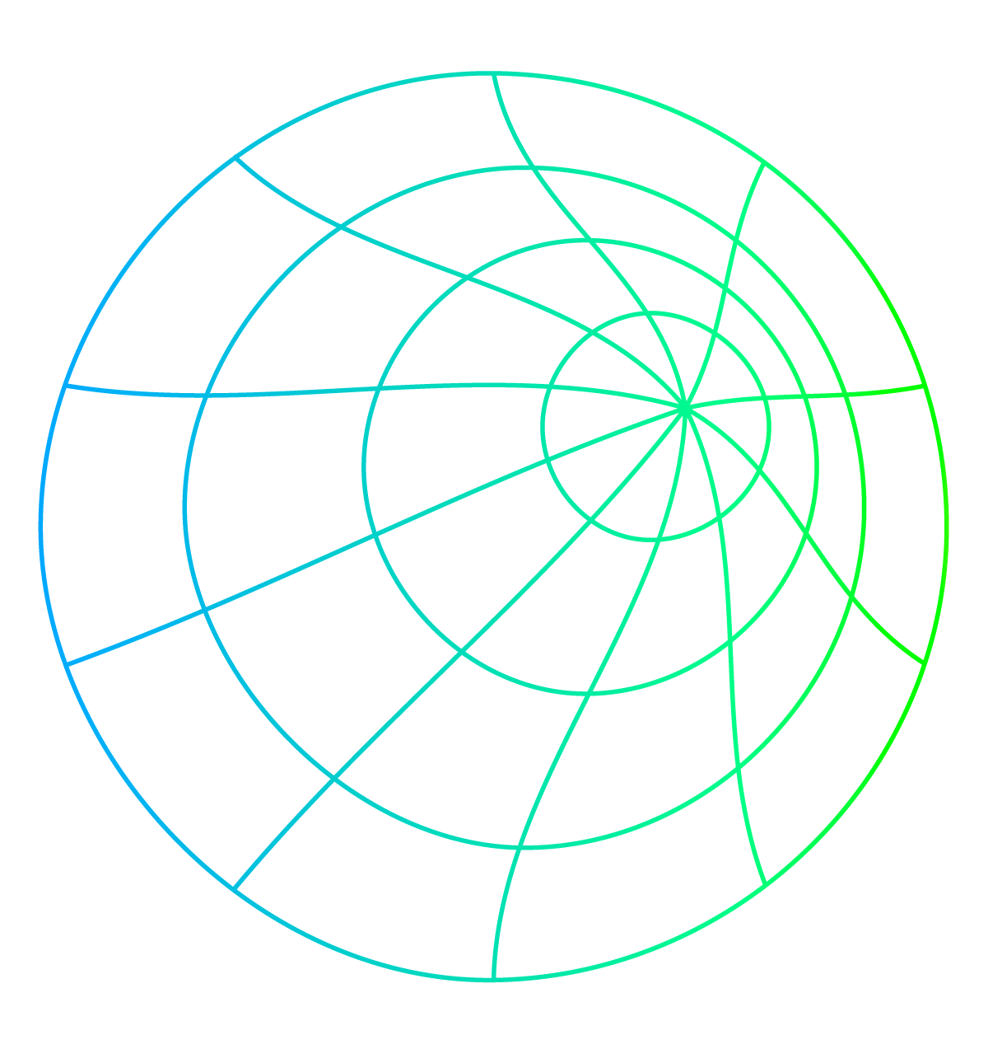

IMAGES ARE SIGNALS
Introduction to Image Compression using DCT
JPEG -
Joint Photographic Experts Group

Slide 2
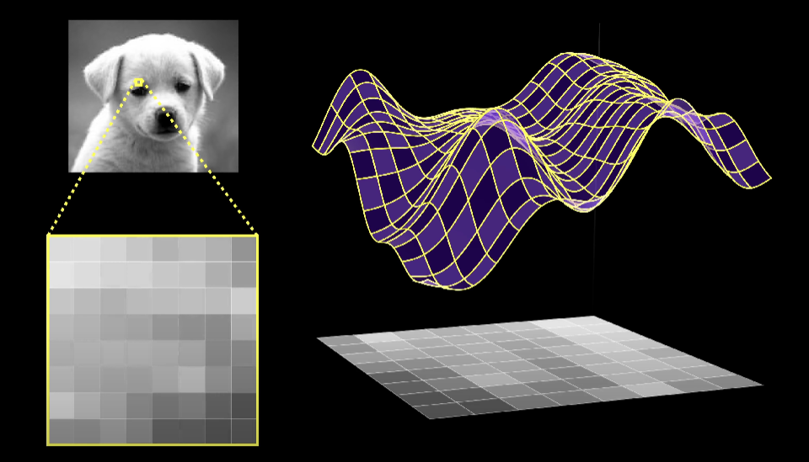
IN A NUTSHELL

Slide 3

Color Treatment
JPEG Encoder
YCbCr
Forward DCT
Quantization
Chroma
Subsampling
Lossless Encoder

Slide 4
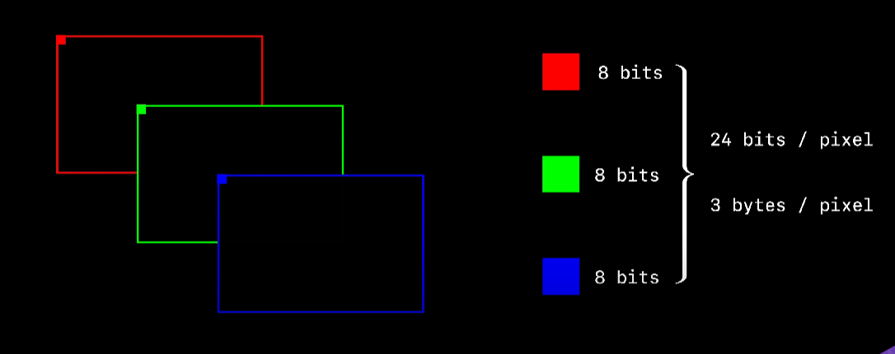
HOW IMAGES ARE STORED

Slide 5
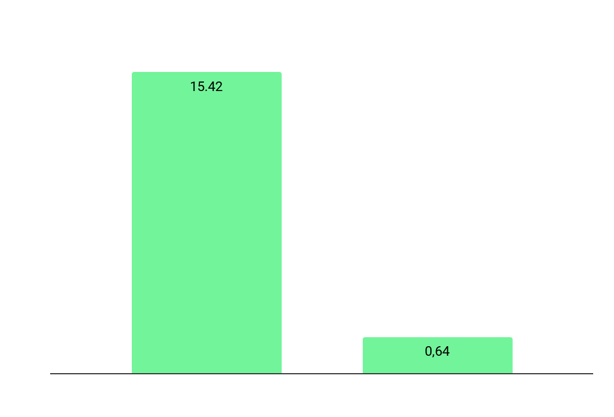

2560 X 2048

Slide 6
Lossy Compression
Encoder
{RGB}
Decoder
{RGB}’

Slide 7
{RGB}’
{RGB}
JPEG Deliberately loses Information so as to achieve high compression.

Slide 8
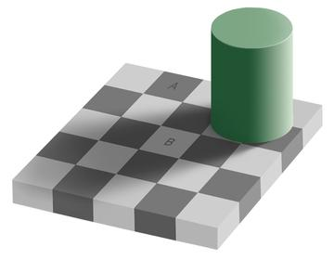
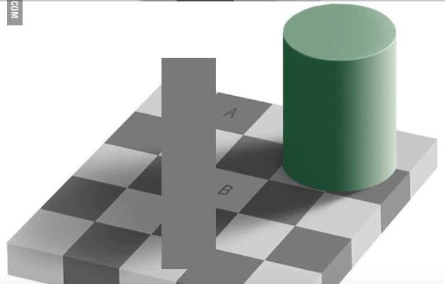
What Color is A and B?
A and B are of the same color
This shows that our eyes are more focused on brightness than color.

Slide 9
RGB Colour Spaces
W(255,255,255)
B(0,0,255)
G(0,255,0)
z
z
B(0,0,0)
R(255,0,0)

Slide 10
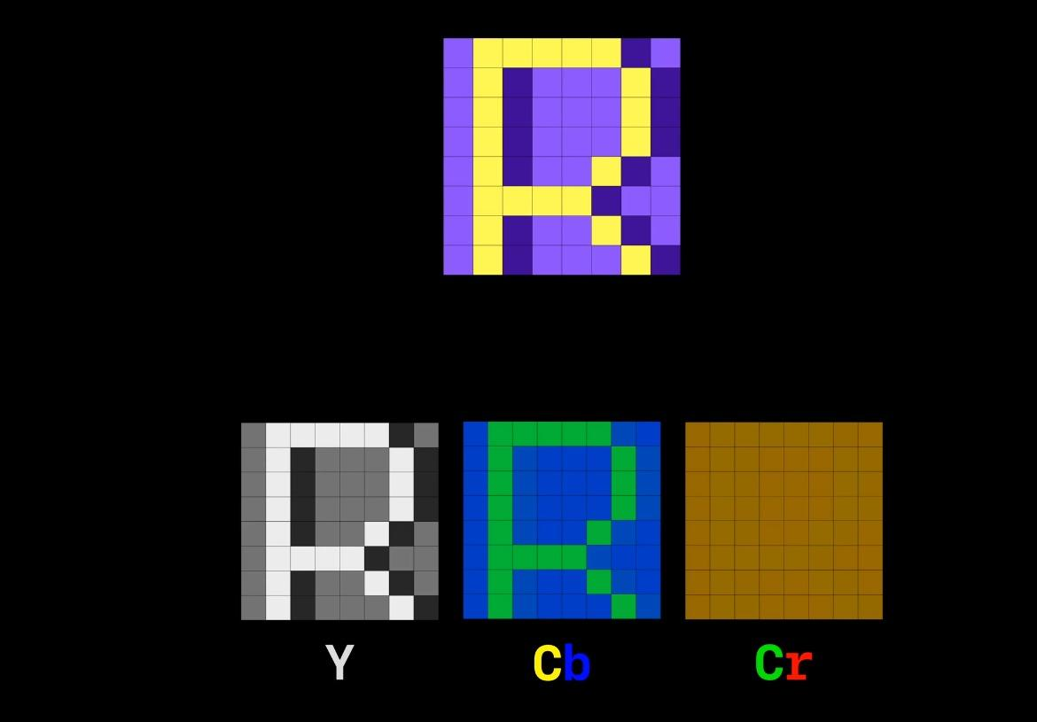
YCbCr Colour Space
[Luma] [Chroma Blue] [Chroma Red]

Slide 11
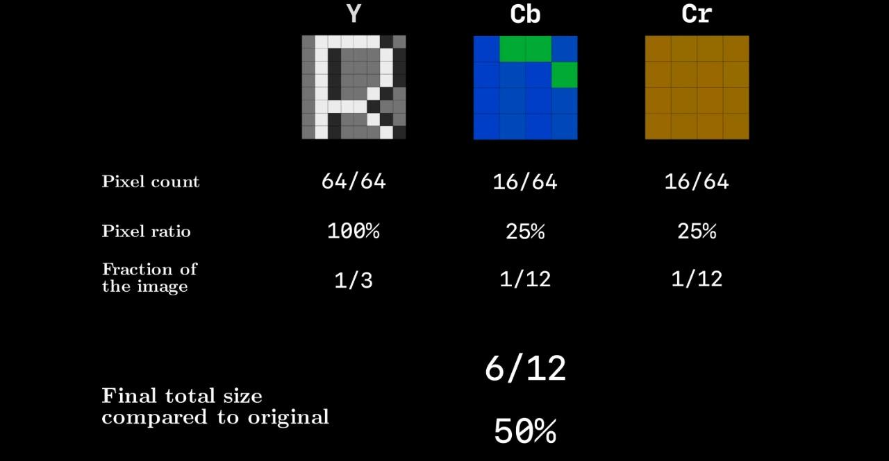

Slide 12
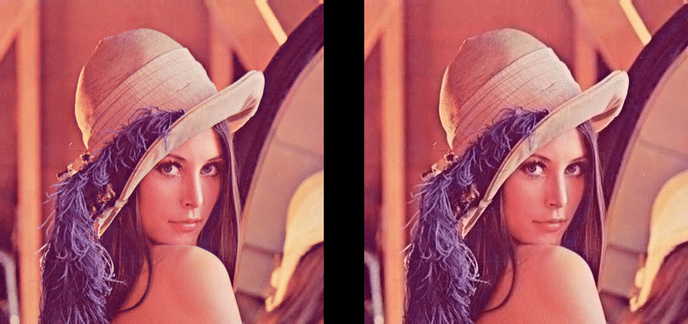
This is the beauty of DSP
Original Image
Chroma Subsampling

Slide 13
Color Treatment
JPEG Encoder
YCbCr
Forward DCT
Quantization
Chroma
Subsampling
Lossless Encoder
Focus on this step

Slide 14
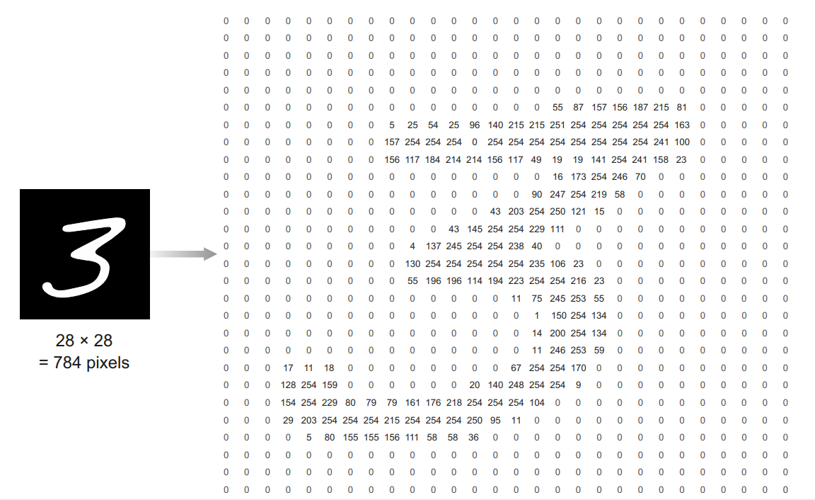

Slide 15
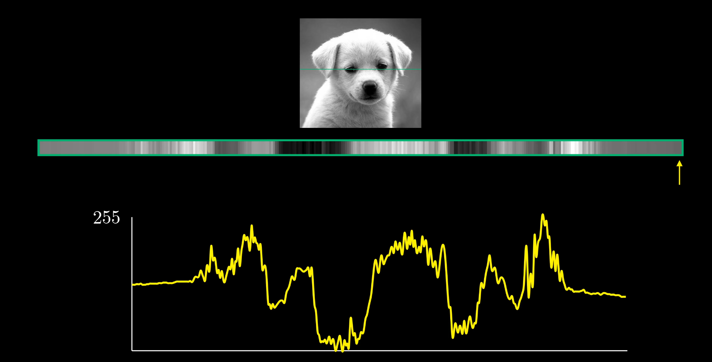

Slide 16
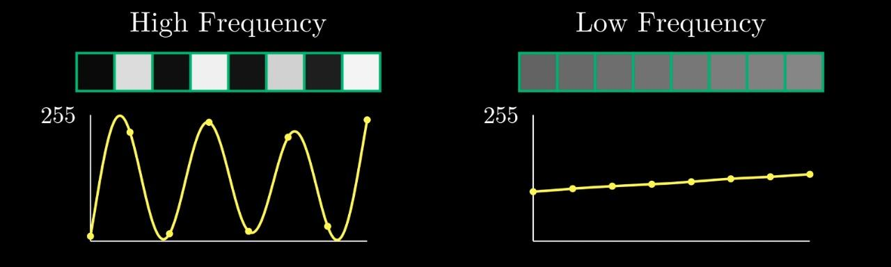
Frequency Components in Image
Real world images tend to have more low frequency components
Human visual system is less sensitive to higher frequency detail

Slide 17
Methods to acquire frequency components from an image
Discrete Cosine Transform ( DCT )
The Discrete cosine transform (DCT) represents an image as a sum of sinusoids of varying magnitudes and frequencies.
The DCT has the property that, for a typical image, most of the visually significant information about the image is concentrated in just a few coefficients of the DCT.
For this reason, the DCT is often used in image compression applications.

Slide 18
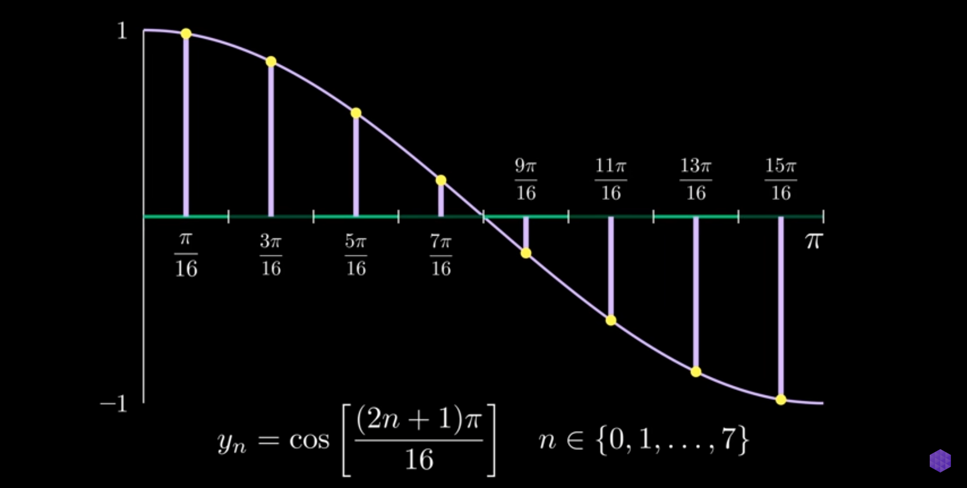
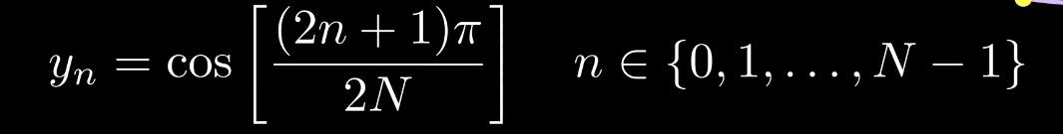
Sampling of a Cosine Wave (y=Cosx)
For N samples,

Slide 19
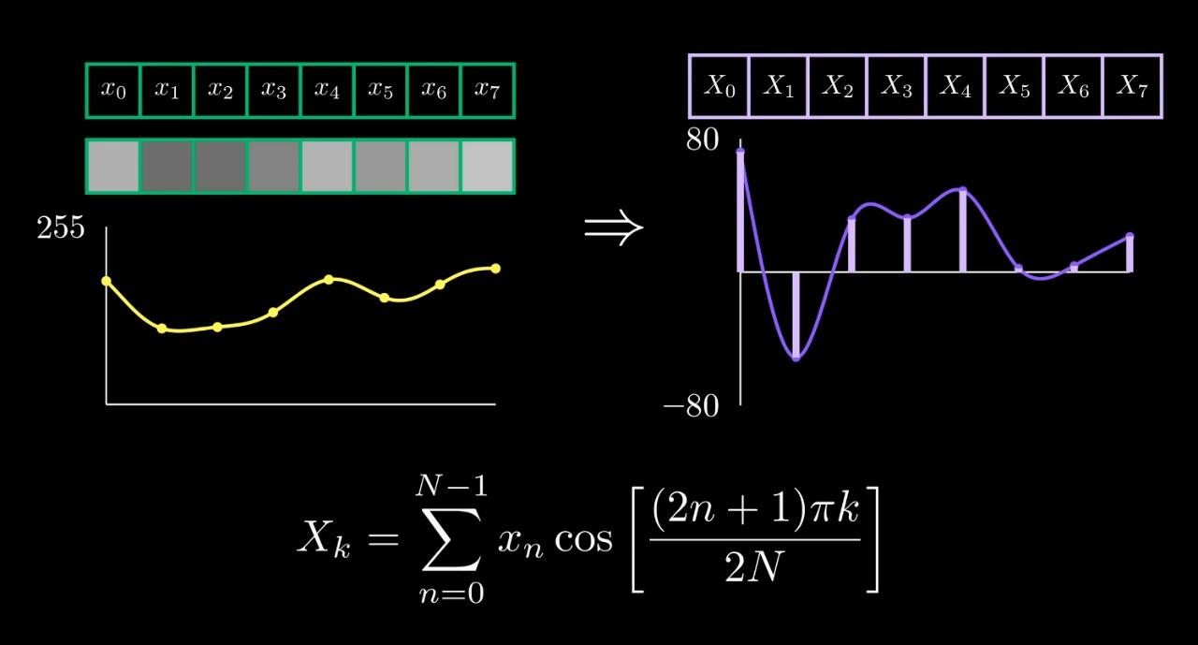
DCT Coefficients
Components of original signal
DCT Transforms

Slide 20
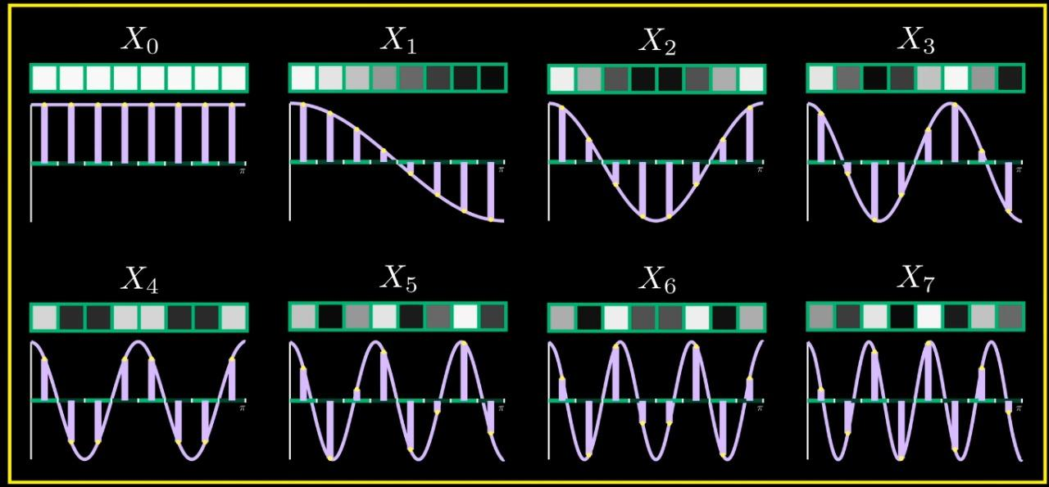

Slide 21
The Process
General Overview
The image is broken into 8x8 blocks of pixels.
Working from left to right, top to bottom, the DCT is applied to each block.
Each block is compressed through quantization.
The array of compressed blocks that constitute the image is stored in a drastically reduced amount of space.
When desired, the image is reconstructed through decompression, a process that uses the Inverse Discrete Cosine Transform (IDCT)

Slide 22
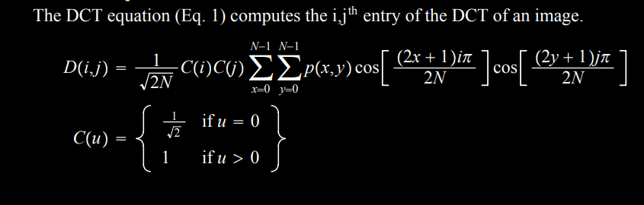
The DCT Equation

Slide 23
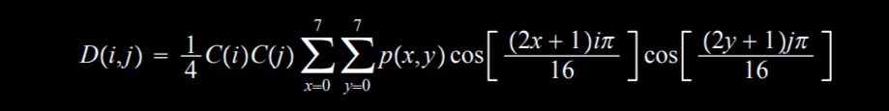
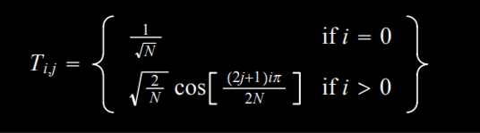
For the standard 8x8 block that JPEG compression uses, N=8
X and y range from 0 to 7. Therefore, D(i,j) would be
To get the Matrix form of the above equation

Slide 24
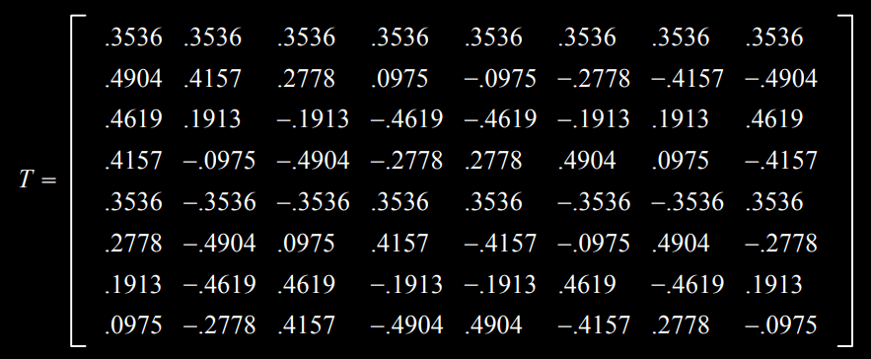

Slide 25
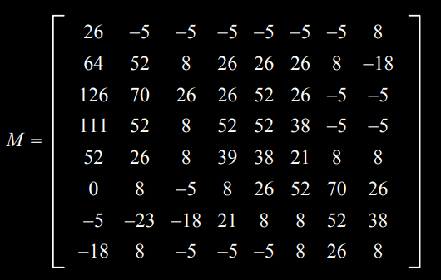
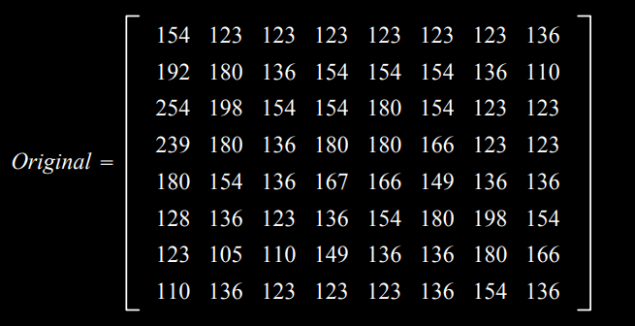
Doing the DCT on an 8X8 block
Original block “leveled off” by subtracting 128 from each entity
Block of Image taken for consideration

Slide 26
Matrix M is first multiplied on the left by the DCT matrix; this transforms the rows.
The columns are then transformed by multiplying on the right by the transpose of the DCT matrix
D = T M T’

Slide 27
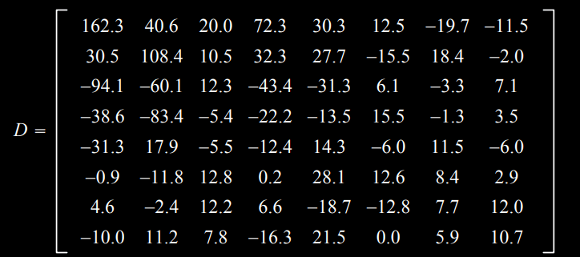
Low frequency components of original block
High frequency components of frequency block

Slide 28
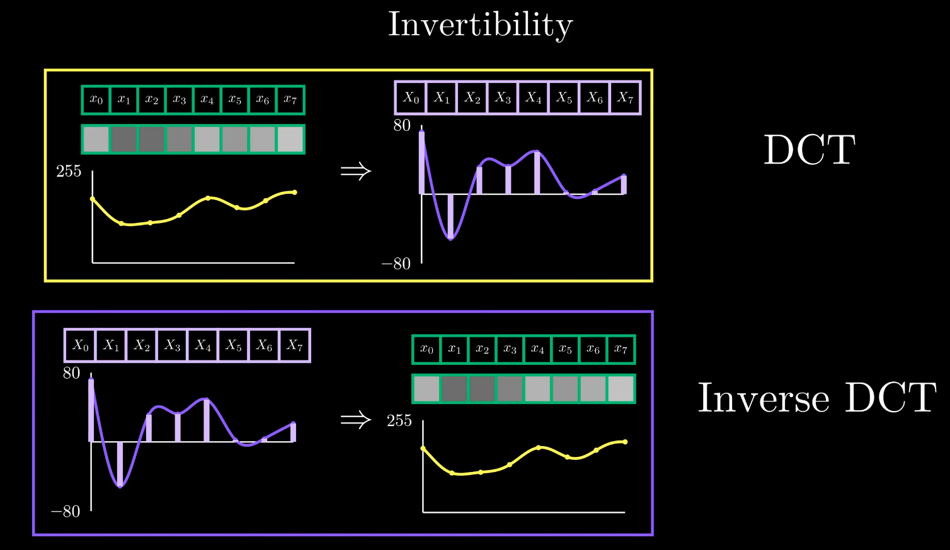

Slide 29
QUANTIZATION
The next step is the Quantization process which is the main source of the Lossy Compression. The values in the quantization table are chosen to preserve low-frequency information and discard high-frequency (noise-like) detail as humans are less critical to the loss of information in this area.
Each DCT term is divided by the corresponding position in the Quantization table and then rounded to the nearest integer as illustrated in the next slide. In each table the low frequency terms are in the top left hand corner and the high frequency terms are in the bottom right hand corner.
Quantization Tables are defined by the JPEG standards for visual experiments and as used to define quality of compression.

Slide 30
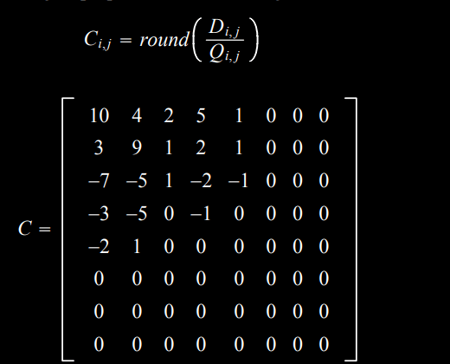
Quantization is achieved by dividing each element in the transformed image matrix D by the corresponding element in the quantization matrix, and then rounding to the nearest integer value. For the following step, quantization matrix Q50 is used.

Slide 31
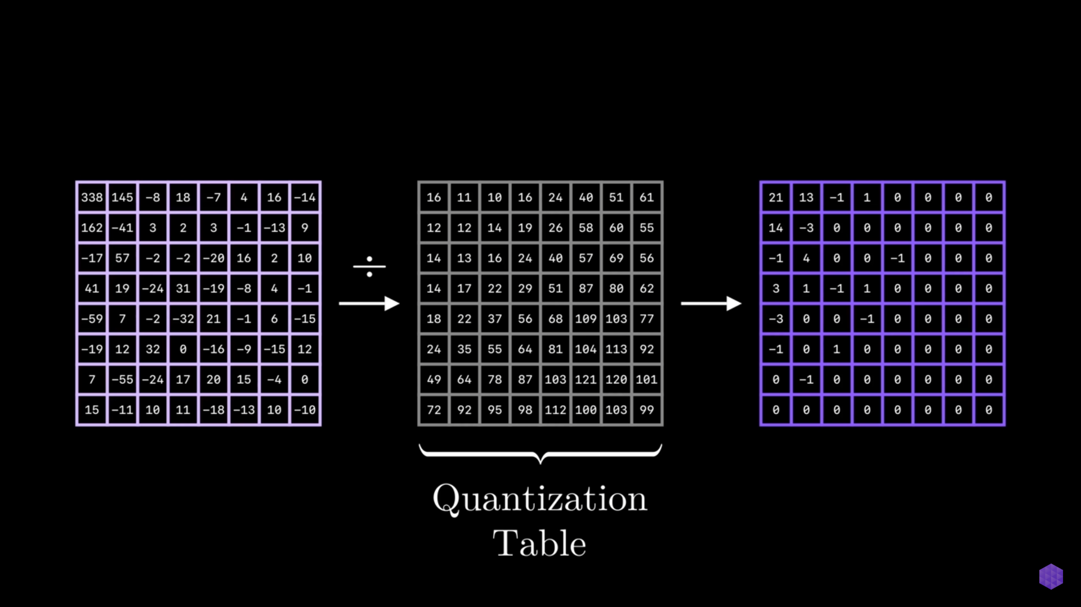
QUANTIZATION EXAMPLE
8x8 DCT Terms

Slide 32
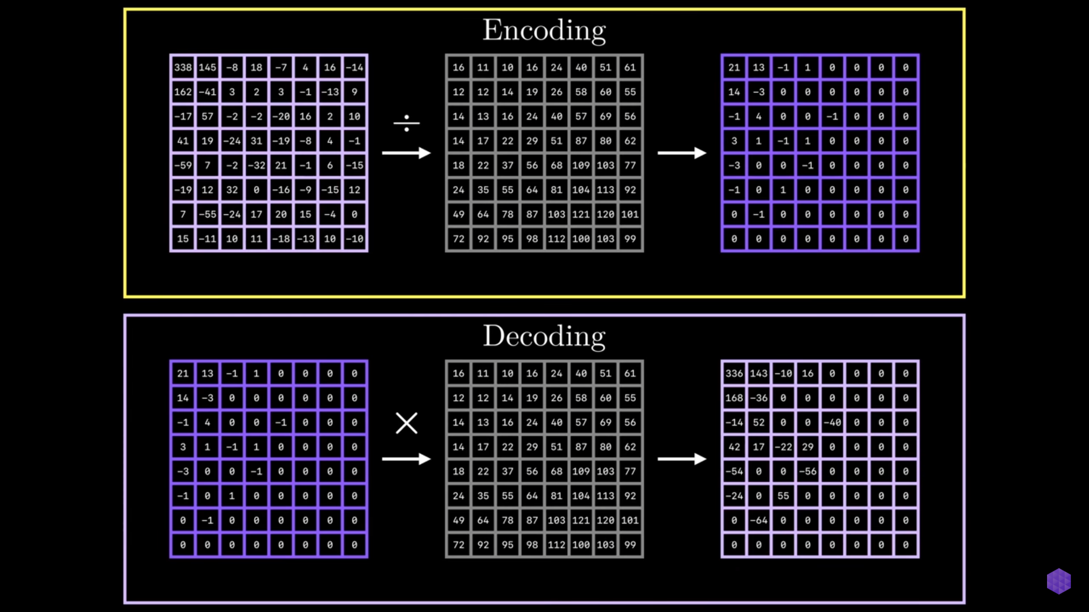
Same Quantization table
As we can see, Decoding does not provide us the original 8x8 DCT matrix i.e, termed as lossy compression.

Slide 33
Same Quantization table
As we can see, Decoding does not provide us the original 8x8 DCT matrix i.e, termed as lossy compression.

Slide 34
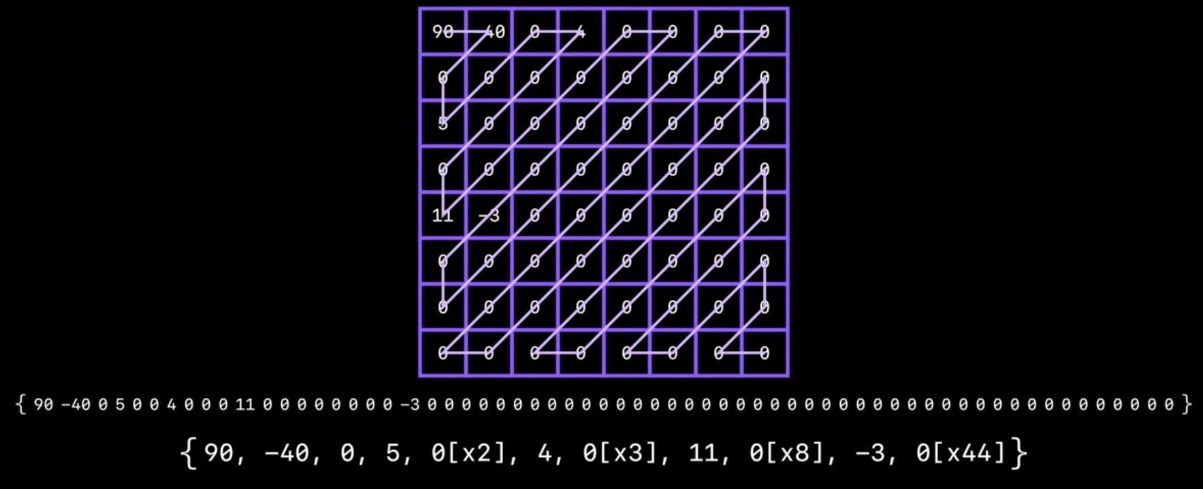
Lossless Encoding
Run Length Encoding

Slide 35
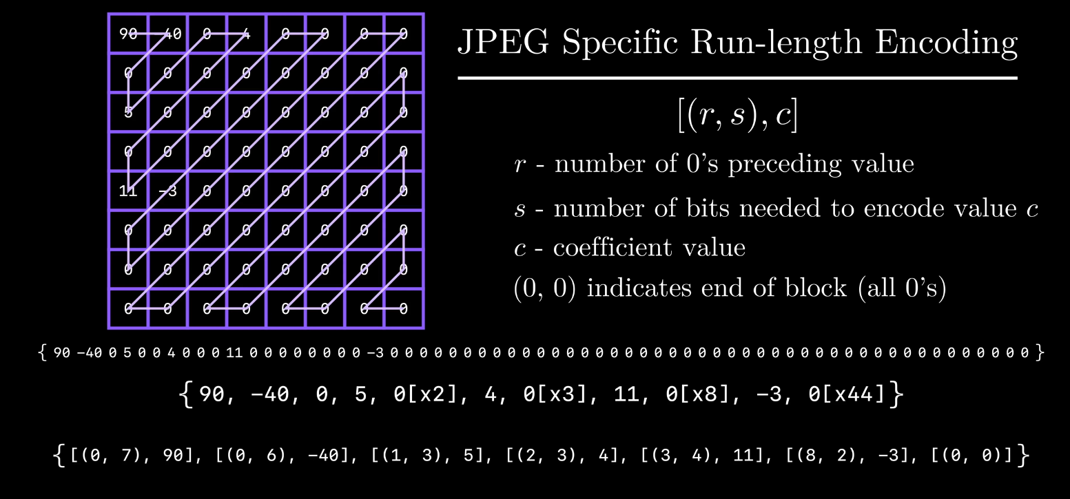

Slide 36
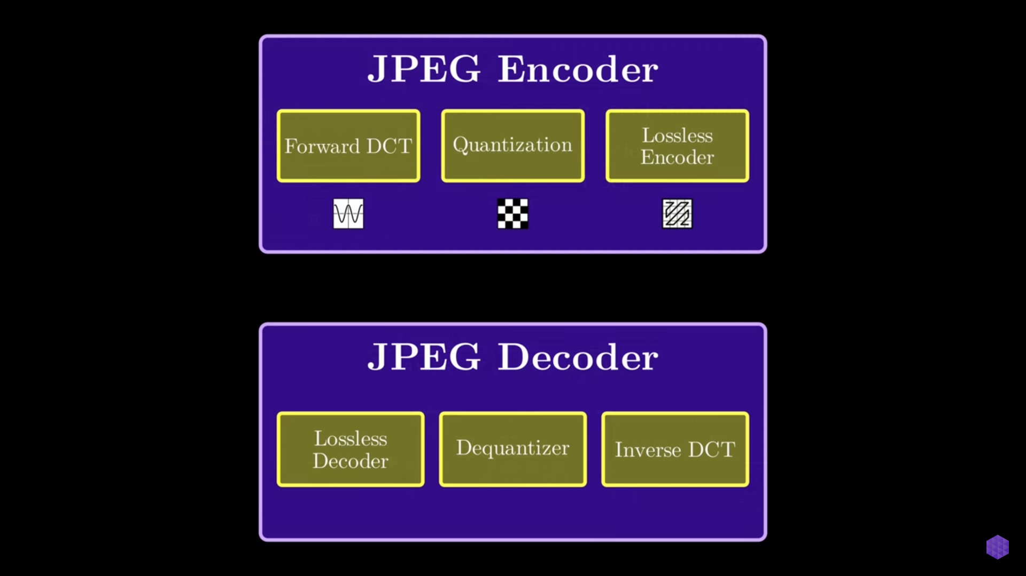

Slide 37
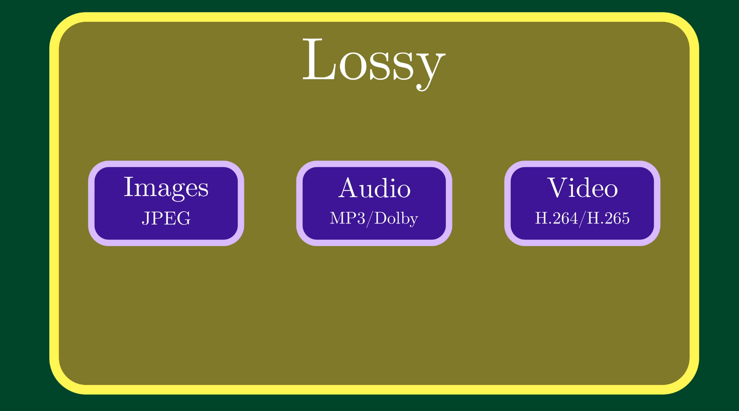

Slide 38
Image Processing Companies
1. Scandit
2. Descartes Labs
3. Tractable
4. Thermoanalytics Inc
5. Visionary.ai
6. Pixium Vision
7. Habile Data

Slide 39
Thank you..
For letting us share our thoughts and not falling asleep :)
Made by -
Harshwardhan Fartale
Prashant Chourasiya
Prashant Prasun
Ajay Sharma
Nishant Bahri
Gaurav Kumar
Dhruv Kaith

